Slide 1

Spectator Hotspots
Do you want to find the best places to cheer on your friends/family on the course, or just to watch the action?
This document shows some of the best spots around the course, how to get there and when you are able to arrive and leave.
If you have any questions, please contact us at info@leamingtonspahalfmarathon.co.uk

Slide 2
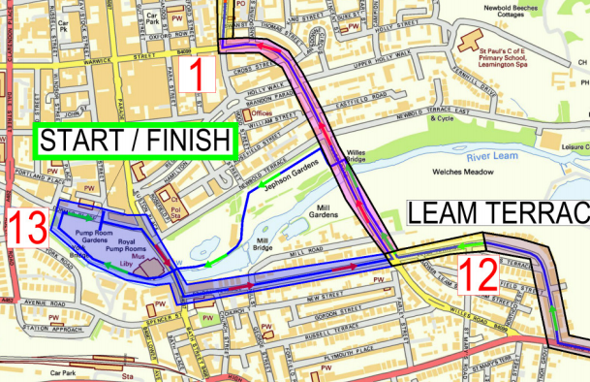
Leamington Spa Town Centre
Jephson Gardens
A beautiful spot to watch the athletes come past. Give them a huge cheer, they are so close to the finish! Bring a picnic or get some cake at the café!
Pump Room Gardens
The main hub of the event, hosting the start and finish, the event village, entertainment and refreshments. If you are driving, there are plenty of town centre car parks you can access.
The New Inn, Leam Terrace
Join the party with the Daventry Road Runners at their drink station, as they cheer on the athletes onto the final mile of the course! You can park on any side roads (e.g. St Mary’s Rd, Beaconsfield St), and arrive and leave whenever you like!

Slide 3
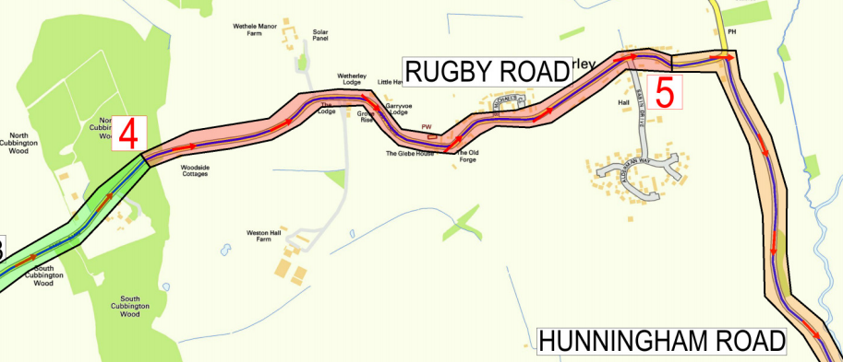
Weston-under-Wetherley
Visit this small and picturesque village and leave whenever is convenient due to one-way road closures allowing traffic to leave eastbound. Make sure to get into the village by 8.30am if driving before the road closures are in place.

Slide 4
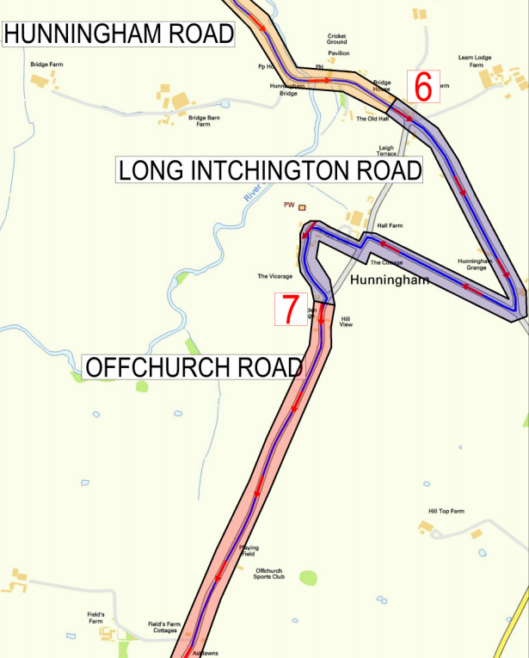
Hunningham
The Red Lion, Hunningham
At half way round the course, the Red Lion is not only a water station for the runners, but has a fantastic garden area with benches to sit and watch the runners come past. The road will be closed from 8.40am – 10:35am, so make sure you get there early!

Slide 5
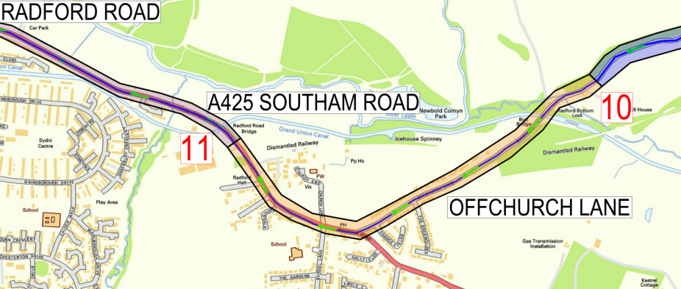
Radford Semele
Another great village to visit – if driving, make sure to arrive before 9am before the road closures are in place. You can drive back towards Leamington at any time due to one-way road closures. But why not walk or cycle down the Grand Union Canal to get there instead, it’s only a couple of miles from Leamington town centre!

